Slide 1
CS5560 KDM Summer 2016 Summarization of Trending US politics 2016 Instructor: Dr YugYung Lee TA: Mayanka Chandra Shekhar, Naga Vadlamudi
Team 8:
Presented by:
Vilas Mamidyala(18)
Vikesh Padarthi(27)
BhumiReddy RanjithaReddy(04)
Dinesh Kumar Bandam(02)

Slide 2
INTRODUCTION

Slide 3
MOTIVATION
We know that the whole world is awaiting to hear the result of US election which are going to be released by the end of this year. Everyone would like to see how these elections are going to be held. Our main motivation behind this project is to analyze the data present in social media like twitter and plot some graphs which shows about which candidate is more famous in social media, the probability of who will be getting elected.

Slide 4
OBJECTIVE:
Main objective of this project is to use NLP, machine learning knowledge to predict the outcome of election result. Using these we can summarize the result of various blogs, news, and editorial matters in newspapers which are related to elections. We will first plot some graphs based on the twitter data which we have collected. And we want to analyze various text data present in the World Wide Web like Wikipedia and summarize these papers.

Slide 5
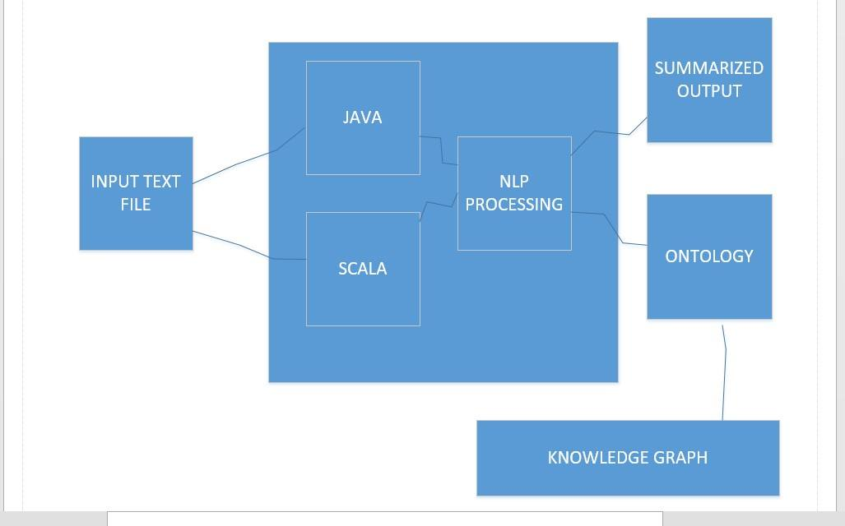
Software Architecture:

Slide 6
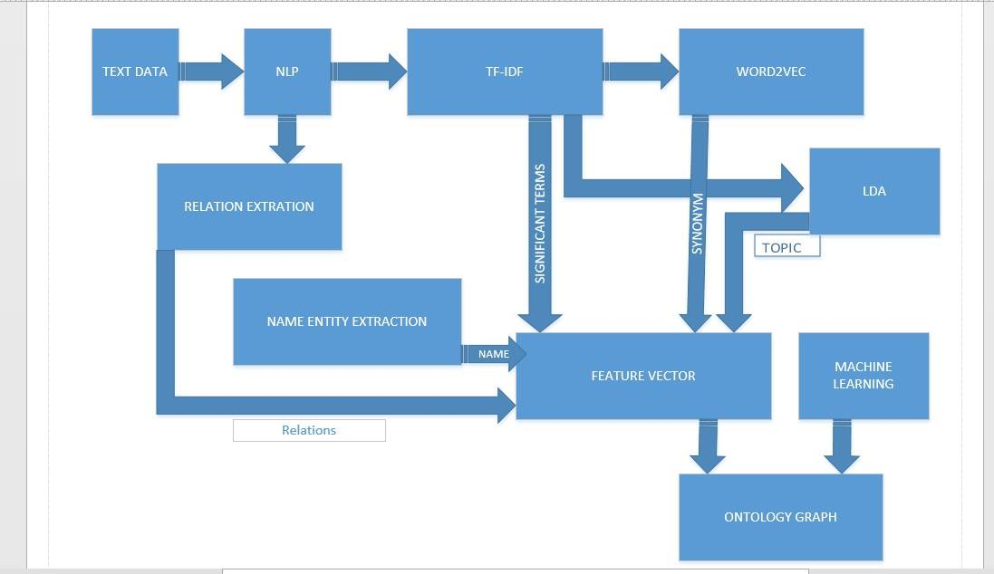
Workflow Diagram:

Slide 7
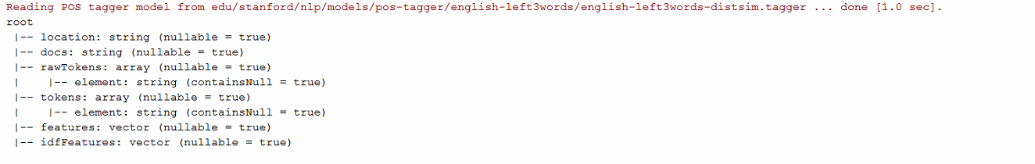
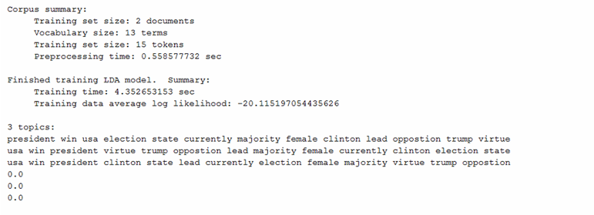
ONTOLOGY:

Slide 8
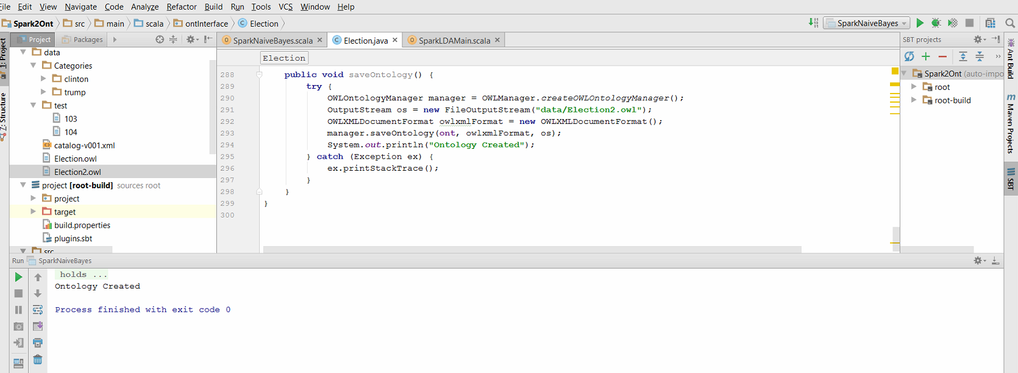

Slide 9
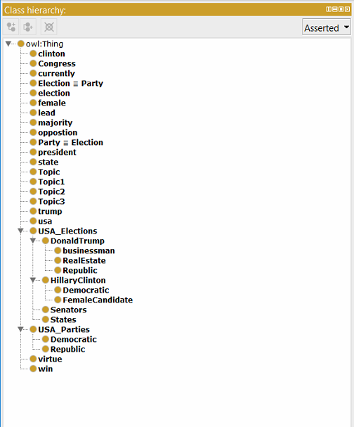
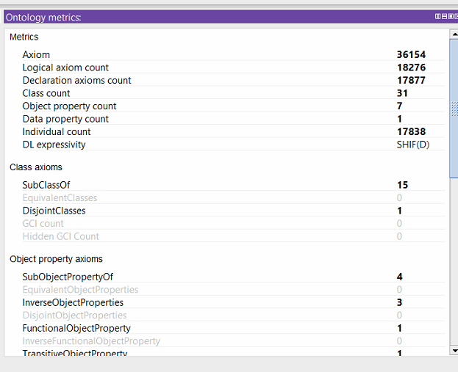
PROTÉGÉ:

Slide 10
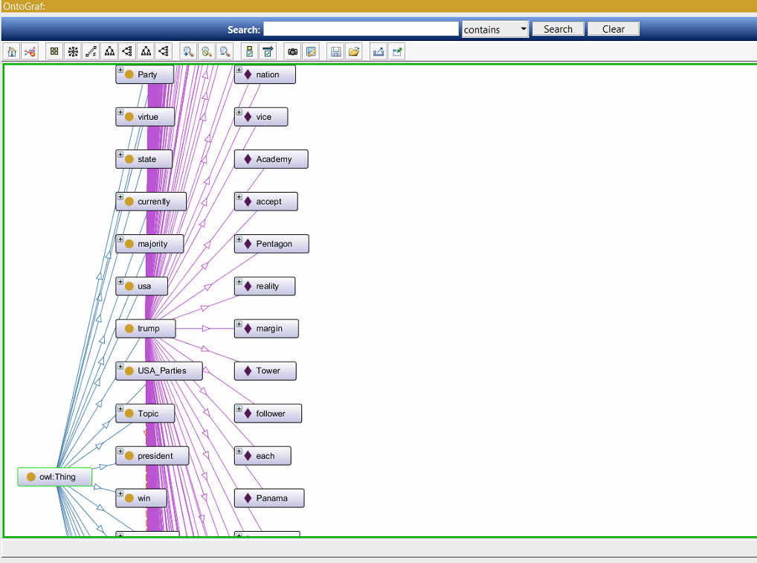
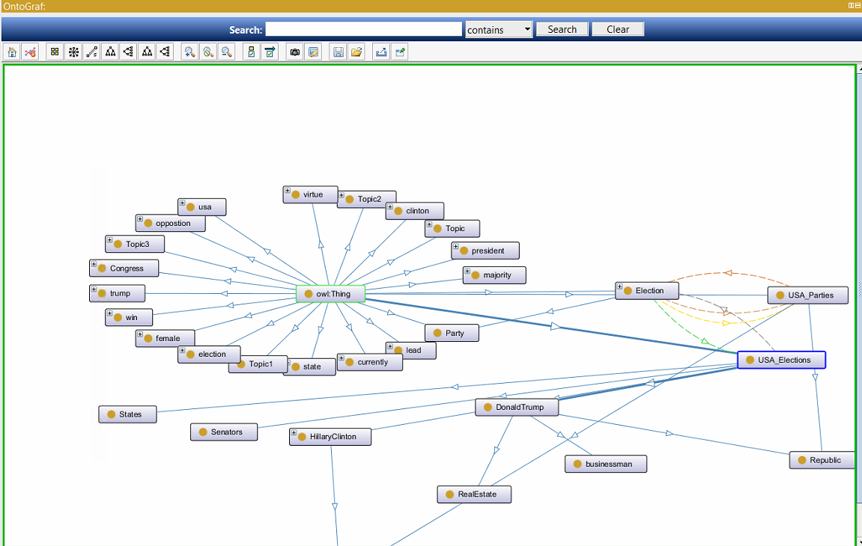

Slide 11
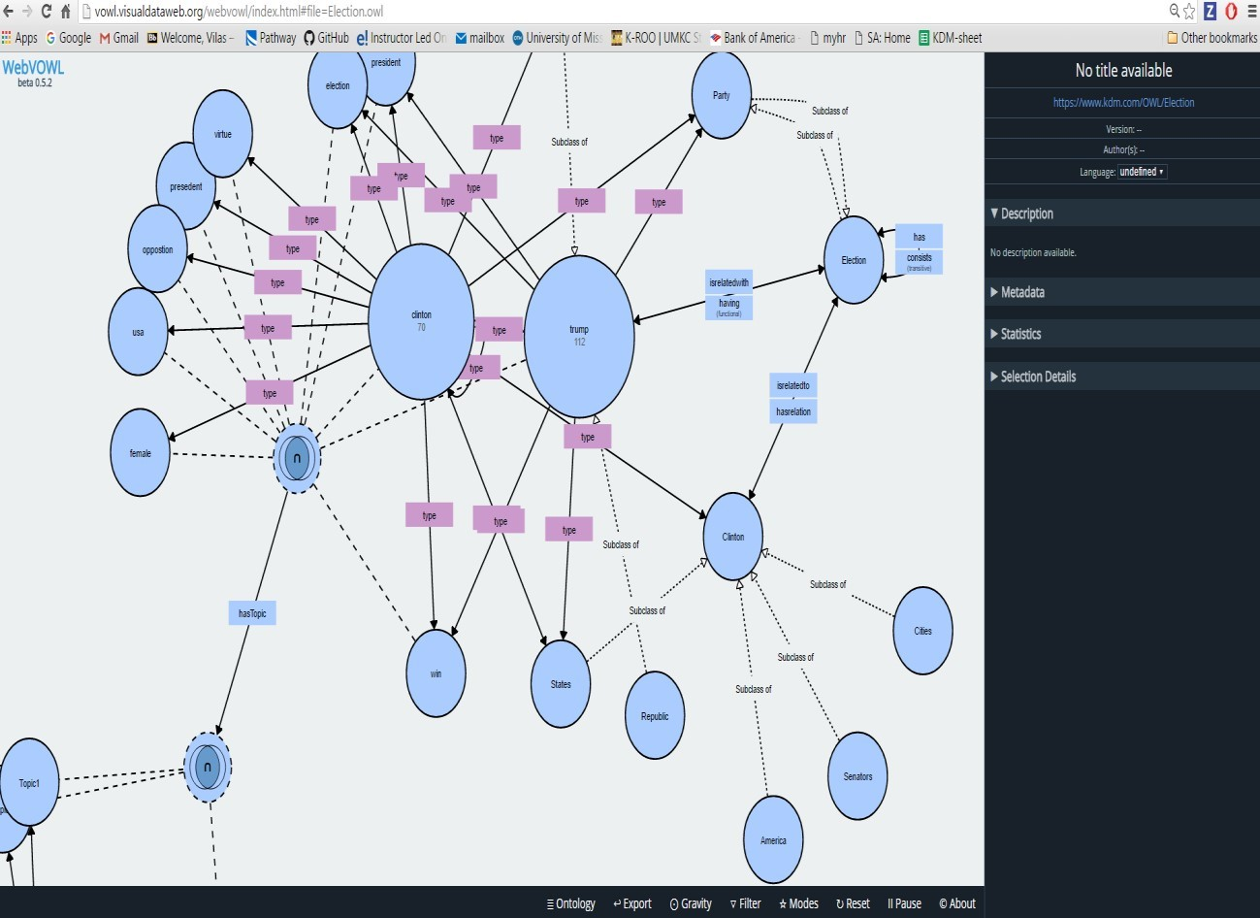
WEB VIEW OF OWL:

Slide 12
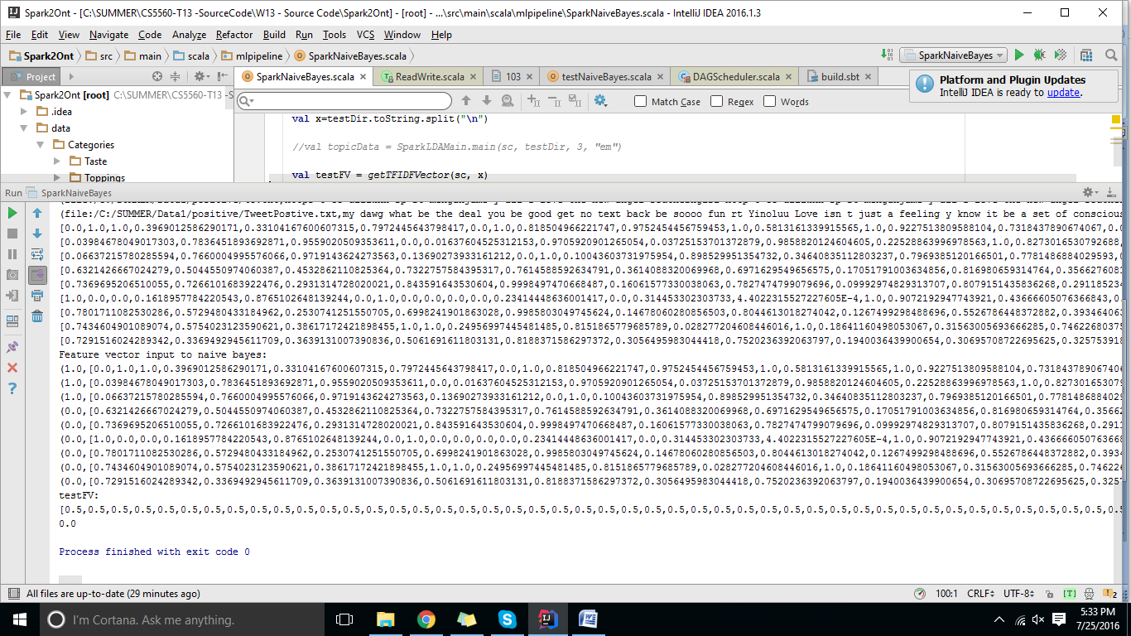
Naïve Bayes Approach for Twitter Analysis :

Slide 13
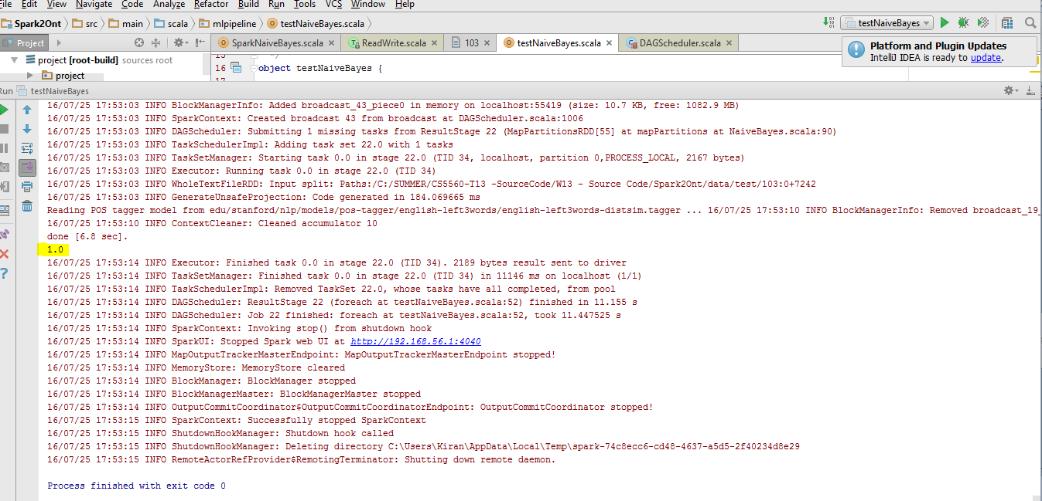

Slide 14
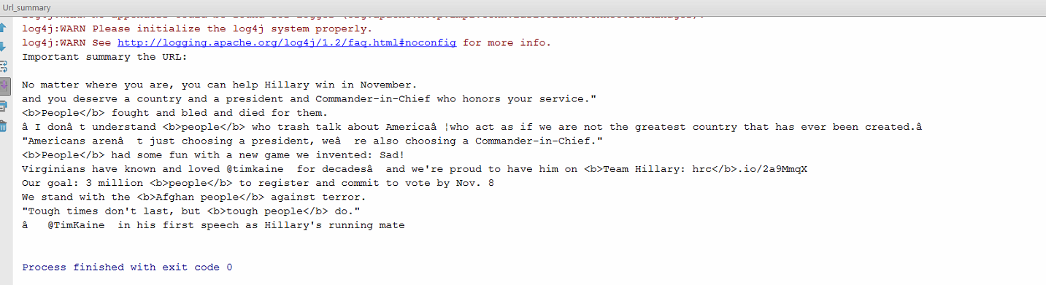
SUMMARIZATION OF GIVEN URL

Slide 15
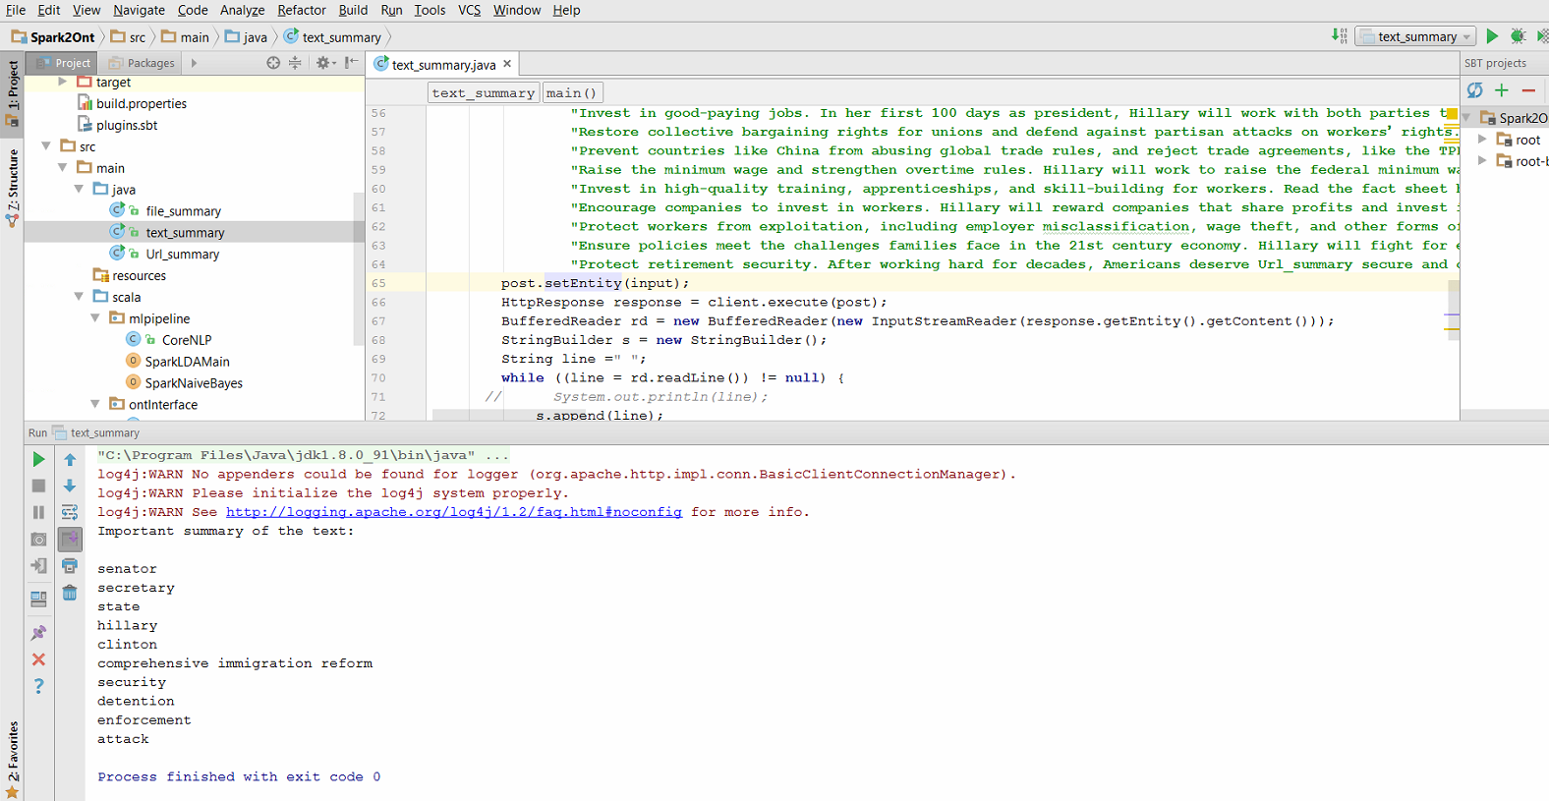
SUMMARIZATION FOR RAW DATA

Slide 16
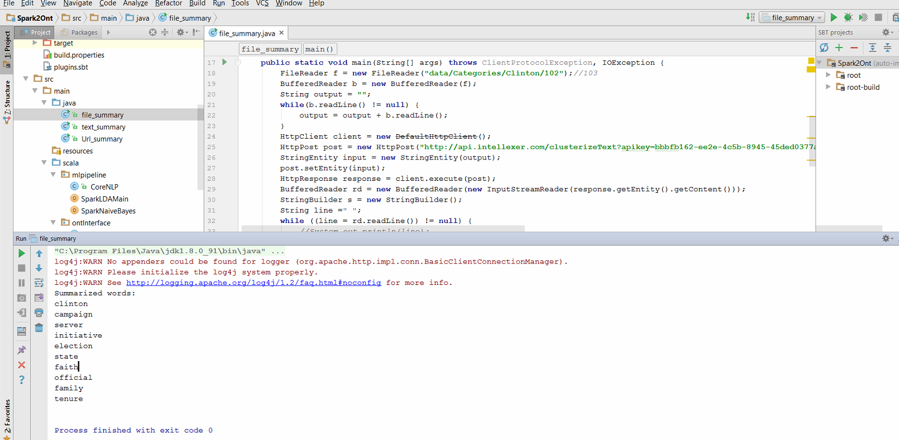
SUMMARIZATION FOR A TEXT FILE

Slide 17
Thank you
Happy Holidays………..Have fun………

